Slide 1
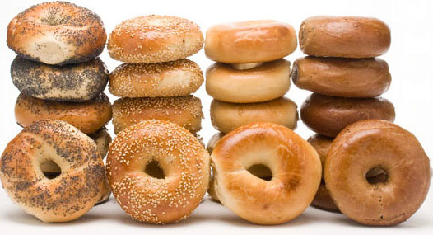
Bagels, Bagels, Bagels

Slide 2
Revelation’s Mark of the Beast Revelation 13:11-17
The Beast from the Earth 11 Then I saw another beast rising out of the earth. This beast had two horns like a lamb, but spoke like a dragon. 12 And this beast exercised all the authority of the first beast and caused the earth and those who dwell in it to worship the first beast, whose mortal wound had been healed. 13 And the second beast performed great signs to cause even fire from heaven to come down to earth in the presence of the people. 14 Because of the signs it was given to perform on behalf of the first beast, it deceived those who dwell on the earth, telling them to make an image to the beast that had been wounded by the sword and yet had lived. 15 The second beast was permitted to give breath to the image of the first beast, so that the image could speak and cause all who refused to worship it to be killed. The Mark of the Beast 16 And the second beast required all people small and great, rich and poor, free and slave, to receive a mark on their right hand or on their forehead, 17so that no one could buy or sell unless he had the mark—the name of the beast or the number of its name.

Slide 4
Revelation’s Mark of the Beast Revelation 13:11-17
The Beast from the Earth 11 Then I saw another beast rising out of the earth. This beast had two horns like a lamb, but spoke like a dragon. 12 And this beast exercised all the authority of the first beast and caused the earth and those who dwell in it to worship the first beast, whose mortal wound had been healed. 13 And the second beast performed great signs to cause even fire from heaven to come down to earth in the presence of the people. 14 Because of the signs it was given to perform on behalf of the first beast, it deceived those who dwell on the earth, telling them to make an image to the beast that had been wounded by the sword and yet had lived. 15 The second beast was permitted to give breath to the image of the first beast, so that the image could speak and cause all who refused to worship it to be killed. The Mark of the Beast 16 And the second beast required all people small and great, rich and poor, free and slave, to receive a mark on their right hand or on their forehead, 17so that no one could buy or sell unless he had the mark—the name of the beast or the number of its name.

Slide 5
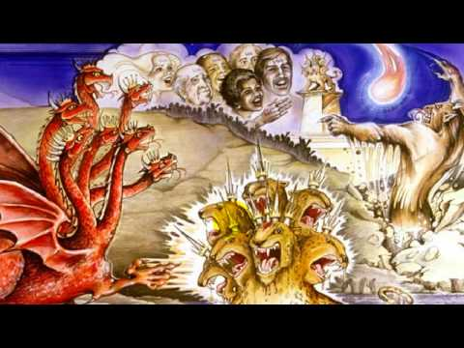

Slide 6
Revelation’s Mark of the Beast Revelation 13:11-17
The Beast from the Earth 11 Then I saw another beast rising out of the earth. This beast had two horns like a lamb, but spoke like a dragon. 12 And this beast exercised all the authority of the first beast and caused the earth and those who dwell in it to worship the first beast, whose mortal wound had been healed. 13 And the second beast performed great signs to cause even fire from heaven to come down to earth in the presence of the people. 14 Because of the signs it was given to perform on behalf of the first beast, it deceived those who dwell on the earth, telling them to make an image to the beast that had been wounded by the sword and yet had lived. 15 The second beast was permitted to give breath to the image of the first beast, so that the image could speak and cause all who refused to worship it to be killed. The Mark of the Beast 16 And the second beast required all people small and great, rich and poor, free and slave, to receive a mark on their right hand or on their forehead, 17so that no one could buy or sell unless he had the mark—the name of the beast or the number of its name.

Slide 7
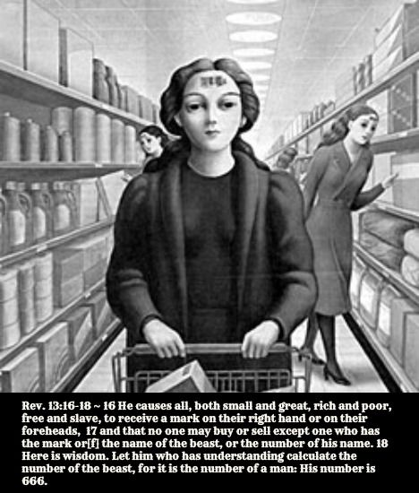

Slide 8
Recap: Seal of God vs mark of the beast
Romans 4:11 And he received circumcision as a sign, a seal of the righteousness that he had by faith while he was still uncircumcised.
Revelation 7:3 “Do not harm the land or the sea or the trees until we put a seal on the foreheads of the servants of our God.”
Ezekiel 9:4 “Go throughout the city of Jerusalem and put a mark on the foreheads of those who grieve and lament over all the detestable things that are done in it.”
Exodus 31:17 It will be a sign between me and the Israelites forever, for in six days the Lord made the heavens and the earth, and on the seventh day he rested and was refreshed.’
Ezekiel 20:20 Keep my Sabbaths holy, that they may be a sign between us. Then you will know that I am the Lord your God.”
Revelation 14:9 -10 “If anyone worships the beast and its image and receives its mark on their forehead or on their hand, ¹⁰ they, too, will drink the wine of God’s fury, which has been poured full strength into the cup of his wrath.

Slide 9
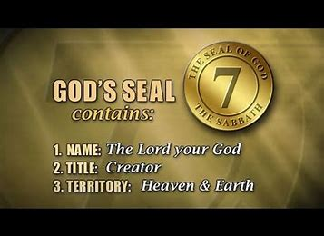

Slide 10
How to receive the Seal of the Living God
2 Corinthians 9:7 Each of you should give what you have decided in your heart to give, not reluctantly or under compulsion, for God loves a cheerful giver.
Daniel 1:8 But Daniel resolved not to defile himself with the royal food and wine, and he asked the chief official for permission not to defile himself this way.
Ruth 1:16 But Ruth replied, “Don’t urge me to leave you or to turn back from you. Where you go I will go, and where you stay I will stay. Your people will be my people and your God my God.

Slide 11
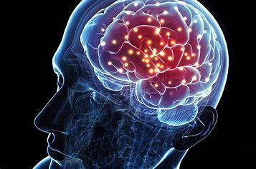

Slide 12
How to be certain to avoid the mark
Psalm 119:105-106 Your word is a lamp for my feet, a light on my path.¹⁰⁶ I have taken an oath and confirmed it, that I will follow your righteous laws..
Matthew 4:4 ‘Man shall not live on bread alone, but on every word that comes from the mouth of God.
Matthew 24:35 Heaven and earth will pass away, but my words will never pass away.
2 Timothy 2:15 Study to shew thyself approved unto God, a workman that needeth not to be ashamed, rightly dividing the word of truth
Psalm 119:11 Thy word have I hid in mine heart, that I might not sin against thee

Slide 13
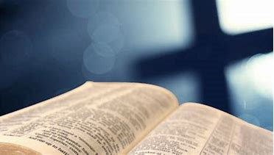

Slide 14
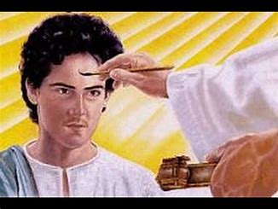

Slide 15
